Slide 1
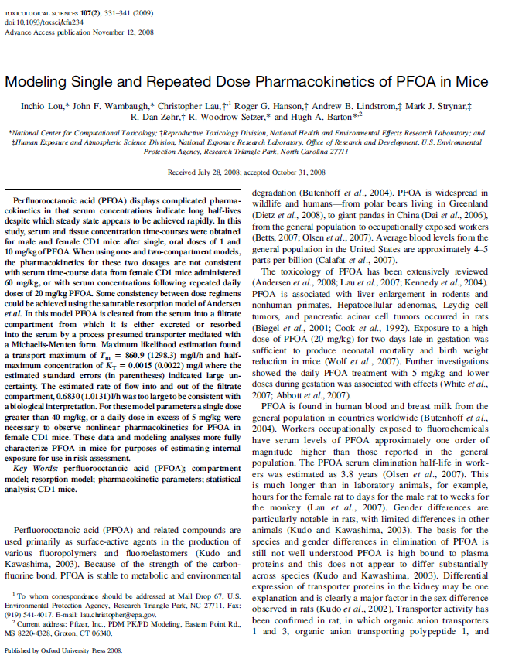
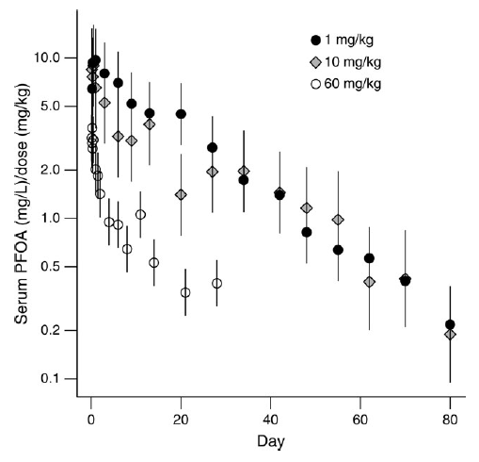
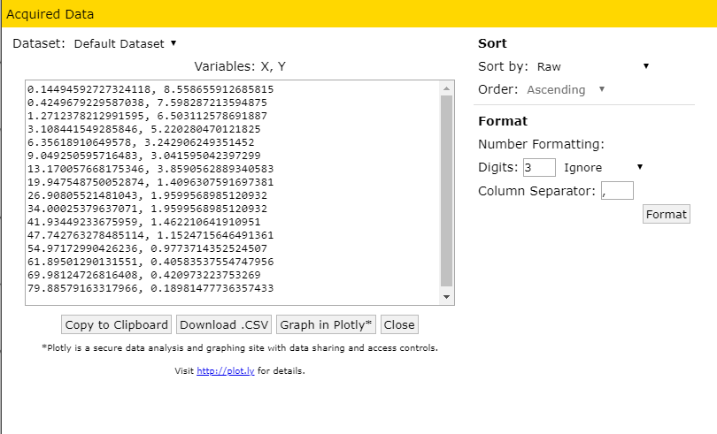
CvTdb Curation
The CvTdb curation process focuses on extracting chemical concentration vs. time data from peer-reviewed papers and annotating the experiments that led to those data

Slide 2
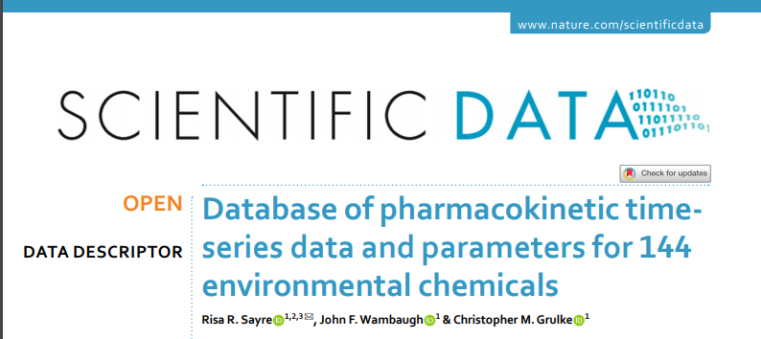
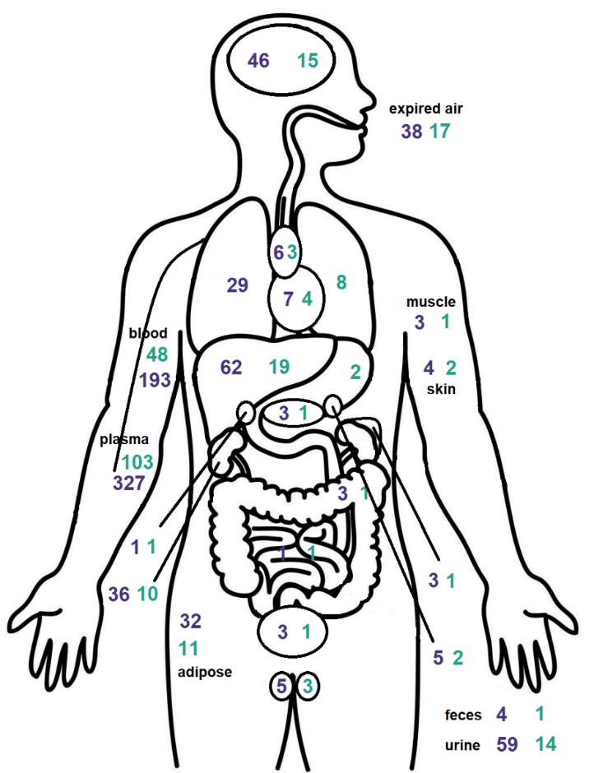
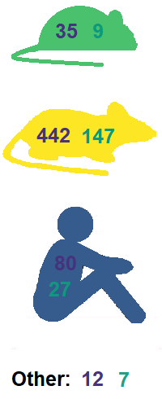
CvTDB: An In Vivo TK Database
Sayre et al. (2020)
EPA has developed a public database of concentration vs. time data for building, calibrating, and evaluating TK models
Curation is focusing on papers with TSCA chemicals and papers on dermal and aerosol exposure
Papers are identified through searching PubMed – not all have CvT data
We are coordinating with other governments to make sure we don’t digitize the same papers
CPHEA has shared old model codes that may contain additional data sets
Access to in vivo concentration vs. time data made it easier to identify coding and other modeling errors
https://github.com/USEPA/CompTox-PK-CvTdb

Slide 3
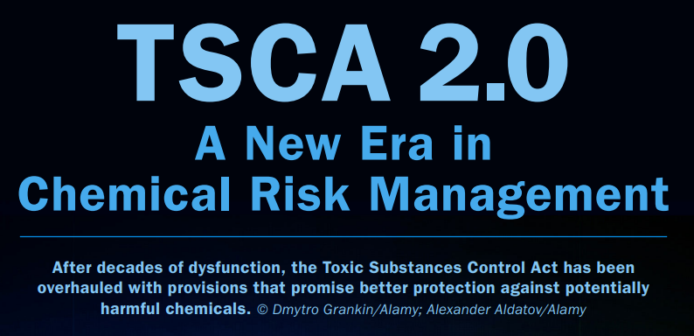

Regulatory Drivers for CvTdB
“Tens of thousands of chemicals are listed with the EPA for commercial use in the United States, with an average of 600 new chemicals listed each year.” U.S. Government Accountability Office
Most of these chemicals do not have in vivo toxicokinetic data
TSCA was updated in June, 2016 to allow more rapid evaluation of chemicals
OPPT performs 20 chemical assessments every two years
How can we provide them with toxicokinetic predictions?
OPP has similar needs for peer-reviewed, statistically-evaluated toxicokinetic models
Schmidt, C. W. (2016)

Slide 4
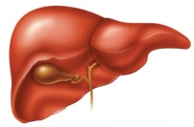

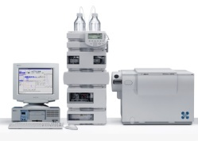
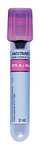
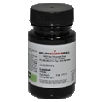
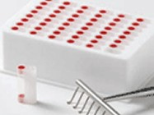
High Throughput Toxicokinetics (HTTK)
In vitro toxicokinetic data
generic toxicokinetic model
In vitro hepatic clearance
Lung Tissue
Q_{cardiac}
Venous Blood
Lung Blood
Arterial Blood
Q_{GFR}
Kidney Tissue
Q_{kidney}
Kidney Blood
Gut Lumen
Q_{gut}
Gut Blood
Plasma protein binding
.
.
.
Liver Tissue
Q_{gut}
1
2
.
.
.
.
Q_{metab}
.
.
.
.
Liver Blood
Q_{liver}
Rest of Body
Q_{rest}
Body Blood
Administrator Wheeler (September, 2019):
“I am directing leadership and staff in the Office of Chemical Safety and Pollution Prevention and the Office of Research and Development to prioritize
…the reduction of animal testing while ensuring protection of human health and the environment.”
httk
high(er) throughput toxicokinetics

Slide 5
Building Confidence in TK Models
x
When you have data you may evaluate a chemical-specific TK model for “chemical x” you can compare the predictions to in vivo data
We can estimate bias and uncertainty
We can consider using the model to extrapolate to other situations (dose, route, physiology) where you don’t have data
However, we do not always have chemical-specific data
In that case we can use a generic TK model, and evaluate that model for those chemicals that do have data
We do expect larger uncertainty, but also greater confidence in model implementation
We can estimate bias and uncertainty, and try to correlate with chemical-specific properties
We can consider using the model to extrapolate to other situations (chemicals without in vivo data)
x
x
Concentrations from CvTdb
x
x
x
Chemical Specific Model
x
Predicted Concentrations
x
y
x
y
y
x
z
x
z
z
Concentrations from CvTdb
y
x
x
y
y
z
Generic
HTTK
Model
x
z
y
z
Predicted Concentrations
Cohen Hubal et al. (2018)

Slide 6
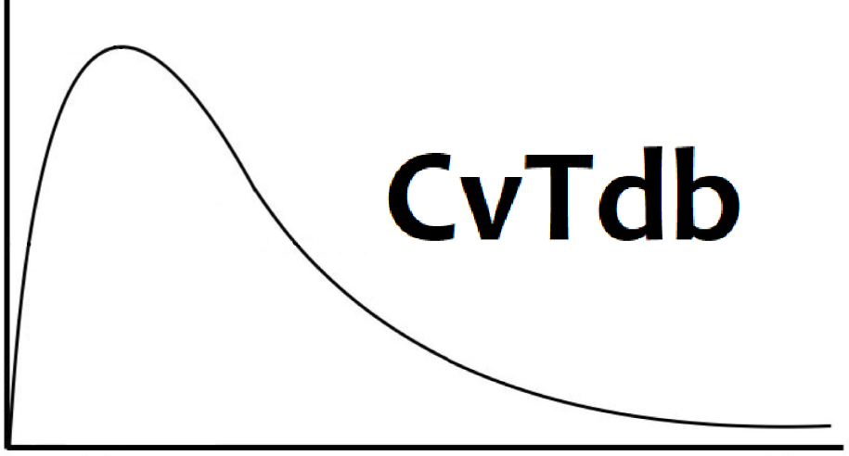
Summary
We need in vivo blood/plasma/tissue vs. concentration vs. time (CvT) data to evaluate high throughput PBTK models for chemical prioritization and regulatory decision making
We are emphasizing the TSCA20 list:
https://www.epa.gov/assessing-and-managing-chemicals-under-tsca/chemical-substances-undergoing-prioritization-high
Also emphasizing data for important pathways:
Dermal exposure
Aerosol Exposure
Short range goal is to submit two papers evaluating generic dermal and aerosol PBTK models by this fall using CvTdb for statistical evaluation
All database contributors will be included as co-authors
Official CvTdb curator will be hired when COOP ends
Contact
John Wambaugh (wambaugh.john@epa.gov) and Chris Grulke (grulke.chris@epa.gov)
with questions

